Slide 1
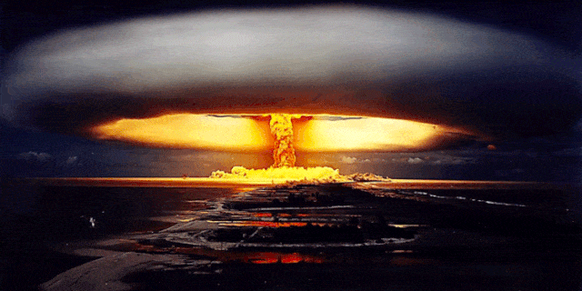
Carbon Emissions in the 6th Mass Extinction
Project by: Iram Pacheco Garcia, McKenna DuVall, Robert Gramlich, and Sunwoo Kim

Slide 2
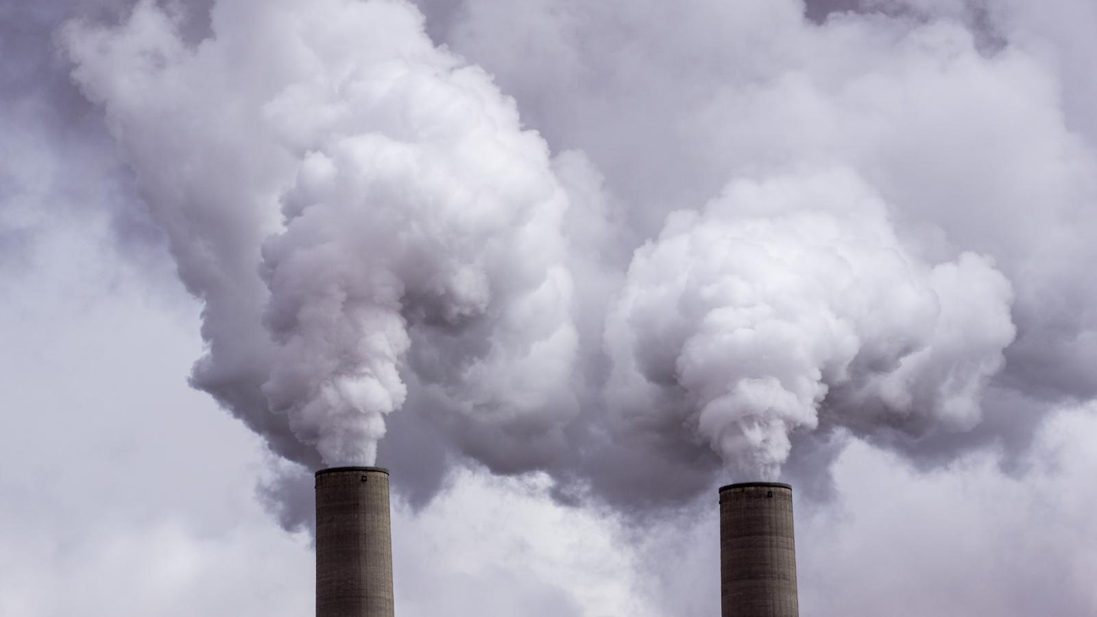
Project Description
Data:
CO2 emissions in United States by state
CO2 emissions by country
Google weather and geocode API
Hypothesis:
If median income increases, then CO2 emissions will increase.
If CO2 emissions increase, then maximum temperature will increase.

Slide 3
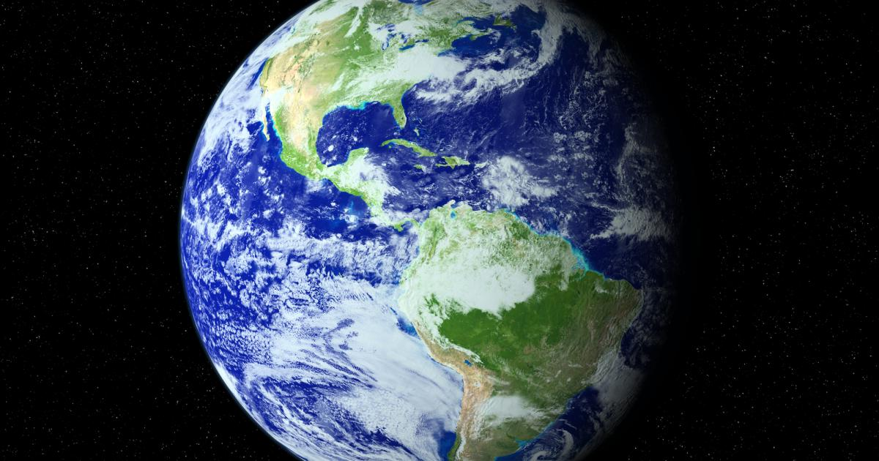
Research Questions
How are carbon emission levels distributed across the globe?
Does a pattern exist when examining median income and CO2 emissions?
Does a pattern exist when examining GDP and CO2 emissions?
What is the relationship between CO2 emissions and maximum temperature?

Slide 4



Data collection
CSV Data
Kaggle
U.S. Census Bureau
U.S. Energy Information Administration
World Bank Climate Change Knowledge Portal
API Data
Google Geocode API

Slide 5
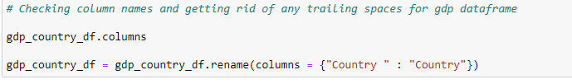
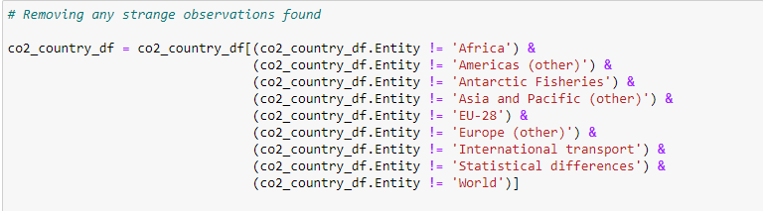
Data Cleaning
Getting rid of trailing/leading spaces
Renaming bad column names for better data manipulation later
Searching for values that do not belong and dropping these observations.
Subsetting data

Slide 6

State Emissions Data:
Majority of emissions by state::
Texas
Pennsylvania
Wyoming
Majority CO2 Consumption per Capita:
Wyoming
Louisiana
North Dakota
Alaska
Median income and CO2 production:
No relationship

Slide 7
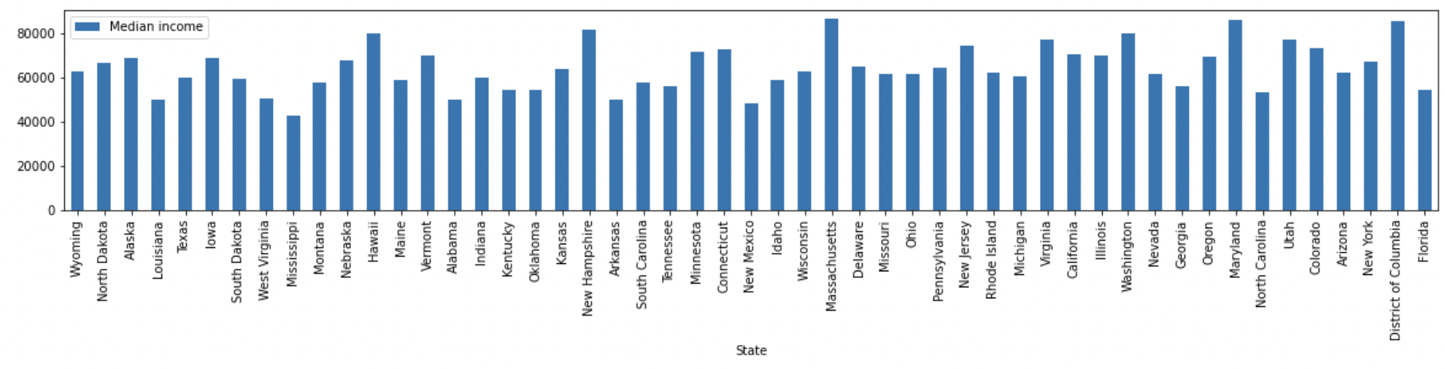
Median Income by State

Slide 8
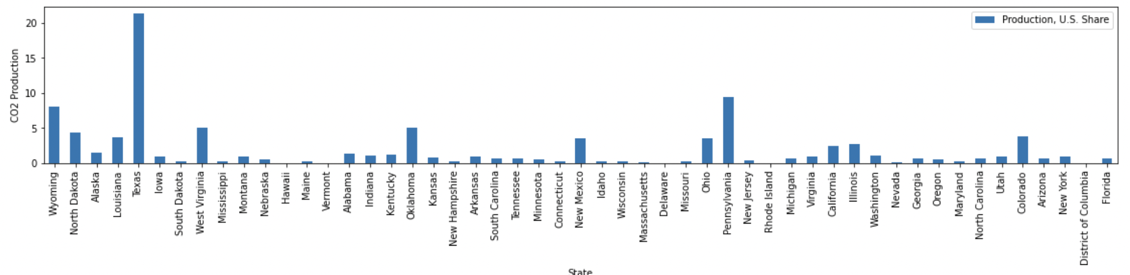
CO2 Production by State
Notes:
Wyoming is top coal mining state - Wyoming is responsible for 57% of CO2 emissions from the extraction and combustion of fossil fuels from federal resources
include population size and density, energy sources, climate and industry mix, according to the Energy Department.

Slide 9
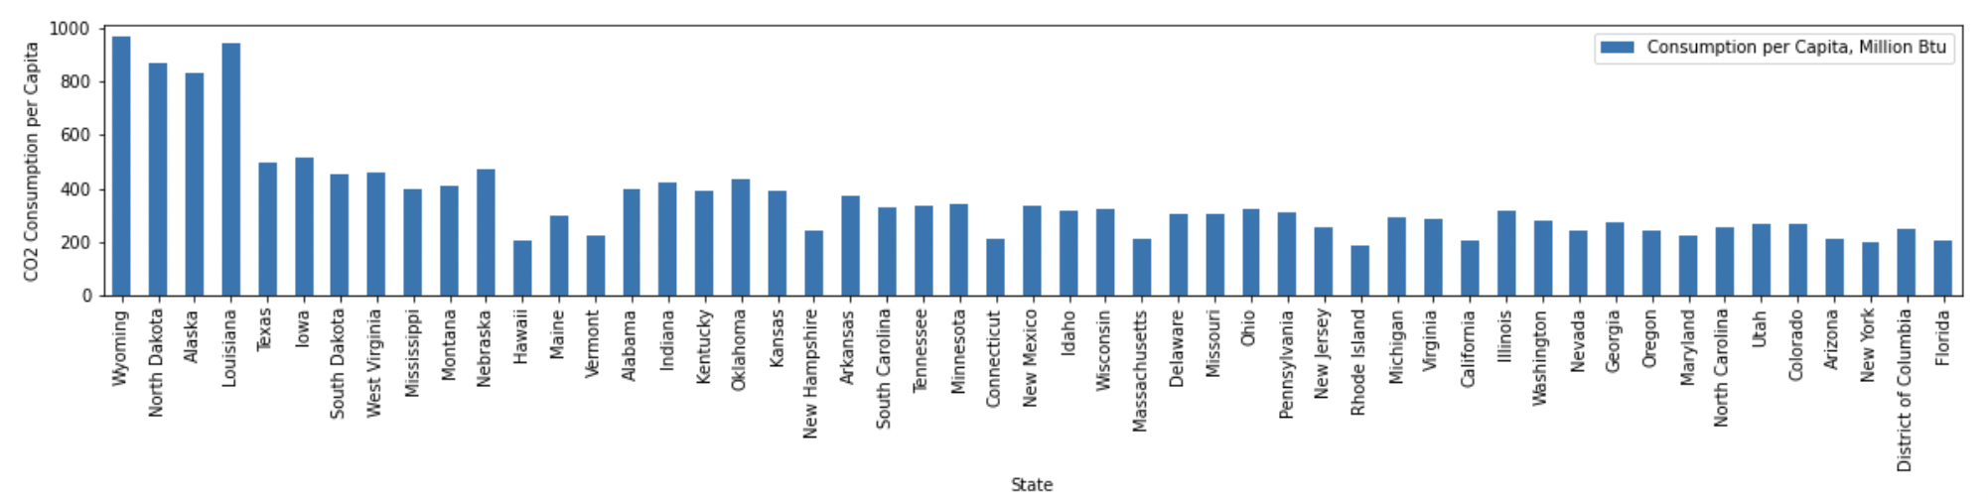
CO2 Emissions per Capita by State

Slide 10
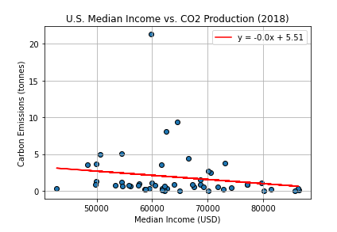
Median Income vs. Carbon Emissions Regression
r = -0.17
r^2 = 0.03

Slide 11
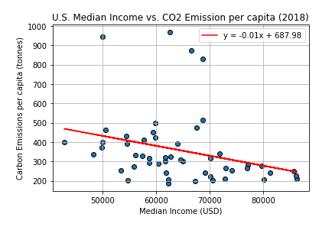
Median Income vs. Carbon Emissions per Capita Regression
r = -0.29
r^2 = 0.08

Slide 12
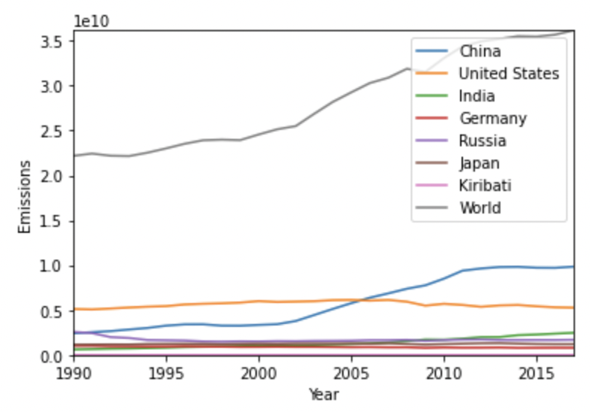
Country Emissions:
Majority of emissions on average (ascending):
China (greatest emitter over the past 30 years and currently)
United States
India
Russia
Japan
Germany
Decreasing emissions:
Russia
Japan
Germany
United States
Increasing emissions:
China
India

Slide 13
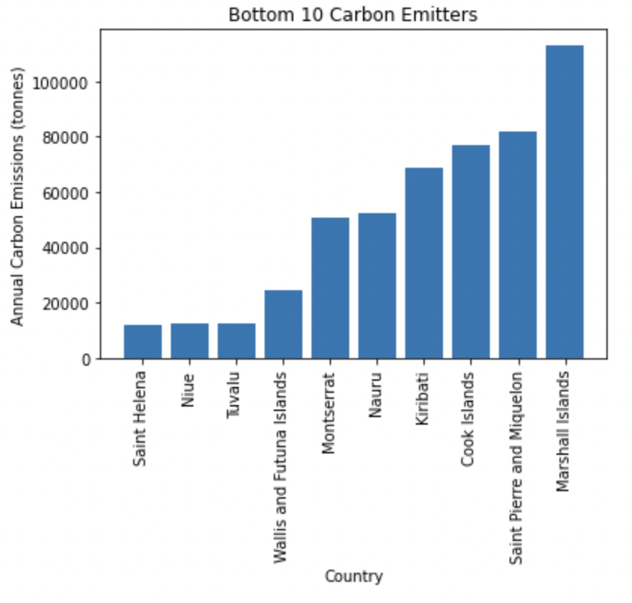
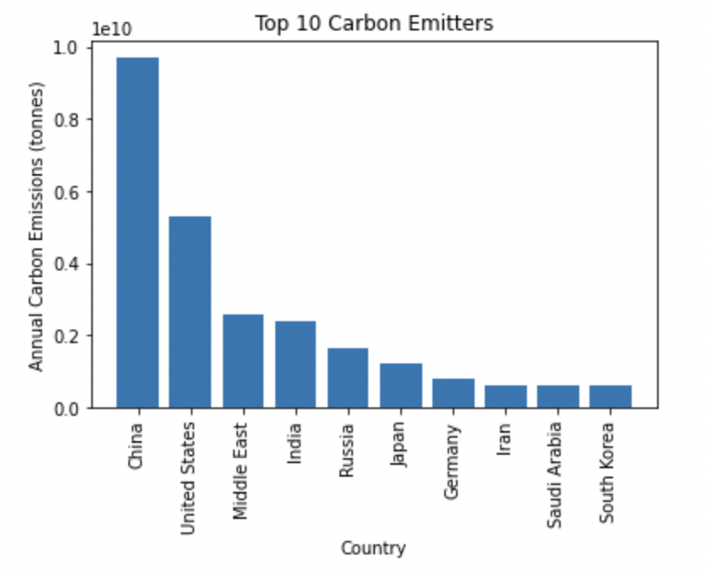
Country Emissions

Slide 14
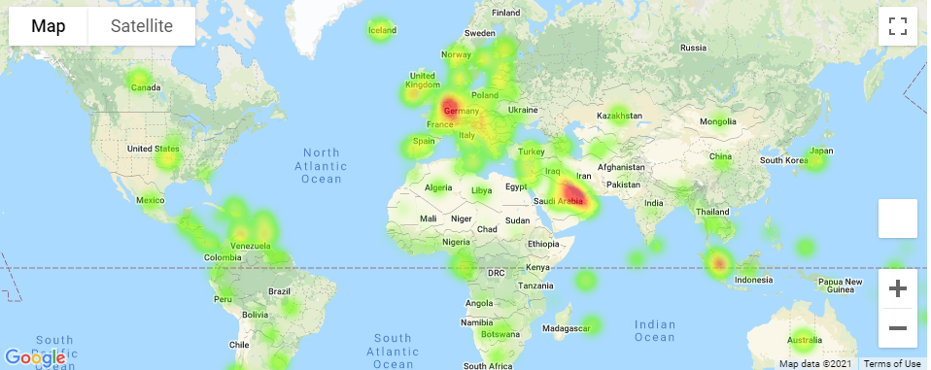
GDP Heat Map

Slide 15
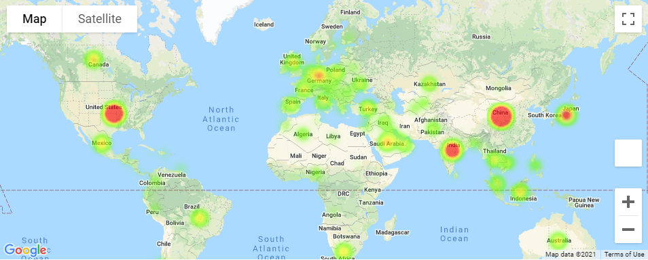
Carbon Emission Heat Map

Slide 16
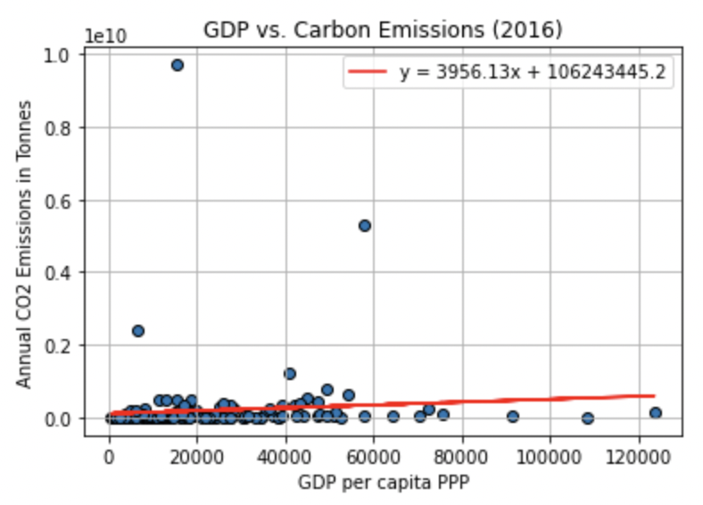
Wealth and Carbon Emissions for Countries
r = 0.09
r^2 = 0.01

Slide 17
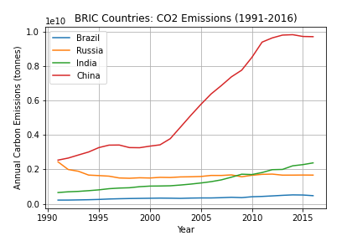
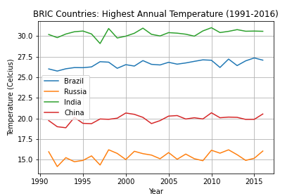
Brazil, Russia, India, China (BRIC) Carbon Emissions and Climate

Slide 18
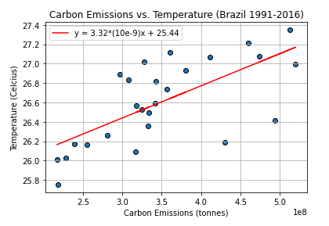
Brazil
r = 0.68
r^2 = 0.47

Slide 19
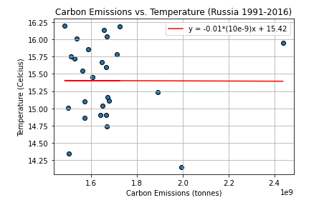
Russia
r = 0.0
r^2 = 0.0

Slide 20
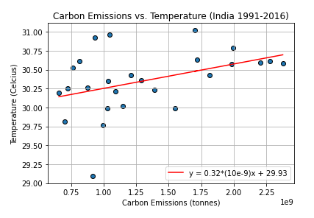
India
r = 0.41
r^2 = 0.17

Slide 21
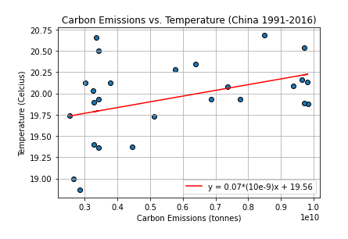
China
r = 0.4
r^2 = 0.16

Slide 22
Conclusion
Our analysis suggests the existence of
A weak, negative correlation between median income and CO2 emissions (and emissions per capita) for U.S. states.
A weak, positive correlation between GDP and CO2 emissions for countries
No correlation between CO2 emissions and highest recorded temperature for Russia
A moderate-strong positive correlation between CO2 emissions and highest recorded temperature for Brazil, India, and China
Considerations for the future:
Find confounding variables and control for them
Use more granular data (city or county level)
Explore other variables’ potential relationships with CO2 emissions (deaths to pollution, natural disasters, rates of renewable energy use)

